Slide 1
We care, We connect

Slide 2
Children are exposed to injuries and death
Despite use of certified Car Seats:
80% of child restraints are used incorrectly
2 out of 3 children are poorly or not at all attached in a car
33% of children who died in a car crash in 2015 were not buckled up
1 child death per week in France
Average number of child heatstroke fatalities per year since 1998 in the USA : 38
The force required to open the buckle of the seat belt is set by law. No buckle device or protective cover which could prevent children from releasing themselves should be used
and certified High Chairs:
Every year, about 9400 young children in the U.S.A. are injured falling off high chairs
The rate of head injuries increased by 22% from 2003 to 2010
Sources: NHTSA, ONISR, www.britax.fr, Huffington Post Dec 2013, www.consumer.healthday.com, , VOIESUR
Notes:
http://www.evenflo.com/SensorSafe/

Slide 3
Our Mission
Develop IoT monitoring solutions in order to:
- improve people’s safety and comfort
- reduce occurrence of everyday life accidents
With initial focus on juvenile industry
to be followed by elder care industry

Slide 4








A team of experts
Edouard Dupont-Madinier
C.E.O.
Laurent Bailliard
C.O.O. and SVP Sales
Patrick Herbault
SVP R&D
Advisors
Juvenile Product Industry
20 years of experience
Patents:
35 registered (France, Europe, World)
Electronic and Communication Systems
30 years of experience
International Business:
Europe, Asia, USA & Canada
Education:

Slide 5
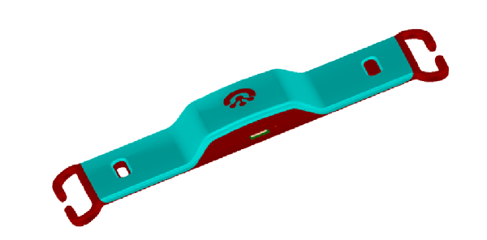


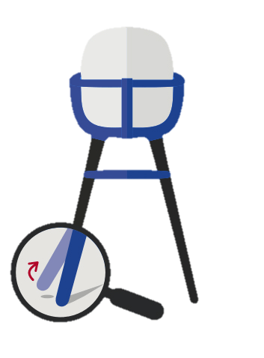

What we do ? design, build and market original IoT solutions
Car Seat Guardian
+
Car Seat Checker
➔

High Chair Guardian
➔

Bluetooth L.E.
App: iOS, Android
Notes:
Modifier les images sur PSD

Slide 6
Two Car Seat solutions designed for the OEM market
High End
Standard
Alerts
Car Seat Guardian(*)
Car Seat Checker
Child detected and properly fastened
✔
Harness position incorrect
✔
Child left alone in car
✔
✔
Dehydration alert
✔
Seat belt/ chest clip /IsoFix fittings FASTENED
✔
✔
* Car Seat Guardian is designed for both OEM and distributors markets

Slide 7
One Highchair solution for both OEM and distributors
Alerts
Car Seat Guardian(*)
Child detected
✔
Child restless
✔
Child left alone
✔
Child tired
✔
Unbalanced chair
✔

Slide 8
























Juvenile products distributors
OEM manufacturers: consolidation and vertical integration
Worldwide Brands: Medium to High End products
Factories: Low to Medium products
Distribution channels: growing Internet market share
Large national and international retailers (35%):
Hypermarkets (40%):
Internet retailers(25%):
Geographic markets: innovation is a key differentiation factor for all
USA & Europe: mature markets
China: fast growing market; new technology is a social elevator
Bluebeep priorities :
Medium to high end juvenile products distributors: Europe, China & USA
Manufacturers with vertical integration capabilities

Slide 9
Juvenile Car Seat and High Chair markets Total annual sales : 13.5 million units / 1 340 M€
Car Seat: 6.5 M units ( Group 0-1)
High Chair: 7 M units / year
Average retail price: 120€
Group 0-1 retail market = 780 M€
Average retail price: 80€
Total retail market = 560 M€
Source: GFK 2014

Slide 10
Bluebeep product benefits:
Continuous monitoring for safety and comfort
Child is
well-seated
Child is
buckled-in
Alarms if misuse of equipment
Alarms if potential dangerous situation
(baby left alone)
Send messages to improve child comfort
(dehydration or fatigue)
✔
✔
✔
✔
✔
Easy to fit & use
Design to fit most
Car Seats
and High Chairs
Self-powered,
no audio or video camera plug-in required
Only one application
Available on
User friendly
✔
Android
✔
✔
✔
Versatile
✔
iOS
✔
Windows Phone
✔

Slide 11
No competition, except for Car Seat Guardian
One US Care Seat competitor: ‘SensorSafe’ of EVENFLO
Sensor Safe by EVENFLO
Car Seat Guardian
Fits all car seats
✔
Fits all car without adaptor
✔
Control babies being left alone in cars
✔
✔
Child monitoring: presence, securely fastened, comfort
✔
Continuous monitoring, no activation required
✔

Slide 12
Recent highlights & short-term priorities
Phase 1
Proof of concept
Patents: CS (x2), HC (x1)
Prototype development: CS + HC
Kind & Jugend, CES Las Vegas
BPI*: R&D funding (200k€ in 2015 and 150k€ in 2016)
J.E.I. status, C.I.R. & C.I.I.
2015-2016
2017-2018
Serial production (CS + HC)
Int’l Patents CS & HC : WIPO PCT
Build revenue stream from Europe, China & USA
Expand juvenile products offer (1 new product in 2019)
Phase 2
Launch Phase
* BPI France : Investment Arm of French Government
Notes:
Recaler le texte Phase 1 et Phase 2

Slide 13
Financing data 2015-2016: 620k€

Slide 14
Geographic and sales targets for 2018
Car Seat Guardian and Checker
Average Retail Price (Europe)
In k units/yr | Europe | China & USA | Total
Car Seat Market | 2200 | 4300 | 6500
Sales 2018 | 60 | 55 | 115
% | 2.7% | 1.2% | 1.7%
In € | Medium Price | High End Price | Bluebeep Price
Car Seat Group 0-1 | 120 | 350 | CS Guardian 90 CS Checker 40
High Chair | 80 | 250 | HC Guardian 80
High Chair Guardian
In k units/yr | Europe | China & USA | Total
High Chair Market * | 1200 | 2300 | 3500
Sales 2018 | 25 | 15 | 40
% | 2.0% | 0.6% | 1.1%
Source GFK : excluding second hand market
*HC : Medium + High end = 50% total Market
Notes:
3 vérifier source

Slide 15
2016-2017 Key Milestones
Dec 2016:
CS and HC prototypes finalized
Q1 2017:
samples sent to OEM and Distributors for evaluation
Q2 2017:
OEM & distributors confirm orders
Q3 2017:
Start of production phase
Q4 2017: sales for CS Guardian, CS Checker and High Chair Guardian’ sales
COSSATO (England ) : « … It would be good to have something, even if it was some sort of prototype to show to our team here…” Andrew KLUGE CEO
RAMP GLOBALTEC (Germany) : “…We did have a lot of positive feedback and customers showed a lot of interest in the full system of your device
and the control app in coalition with our prototypes..”
Andreas PLESS COO

Slide 16
Funding Requirements : Step 1
250k€ for Pre-Production Phase
•New investors funding : 250 k€
•Deal specifications:
- Completion: Dec 31, 2016

Slide 17
Funding Requirements : Step 2
350k€ for Production and Sales Phase
•New funding : 350 k€
•Deal specifications:
- Capital funding: 175k€
- Debt funding: 175k€
- Completion: June 30, 2017
•Exit strategies:
- IPO (2020)
- Business sale to players of IOT,
Juvenile / Elder care industries

Slide 18
Financial forecast 2017-2019
In k € | 2017 (3 months) | 2018 | 2019
Units sold (*) | 19 500 | 155 000 | 310 000
Revenue | 402 | 2 920 | 5 423
% (Growth) | - | - | 93%
EBITDA | -316 | +103 | +666
% (Revenue) | -78% | 3% | 12%
Net Cash (After financing) | +258 | +343 | +445
* Including CS Guardian, CS Checker, HC Guardian
Notes:
FAIT

Slide 19
Edouard Dupont-Madinier 06 17 11 65 37 info@bluebeep.eu www.bluebeep.fr

Slide 20
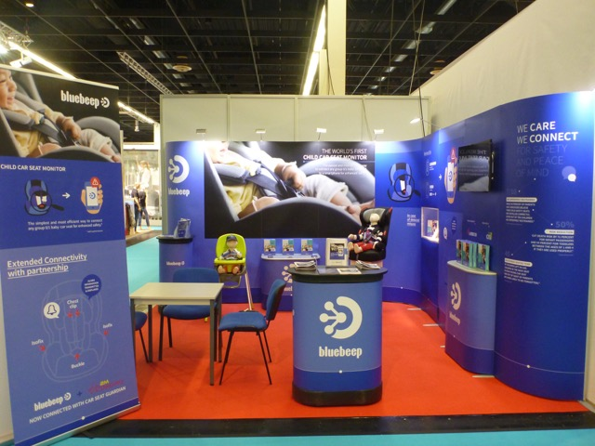

Slide 21
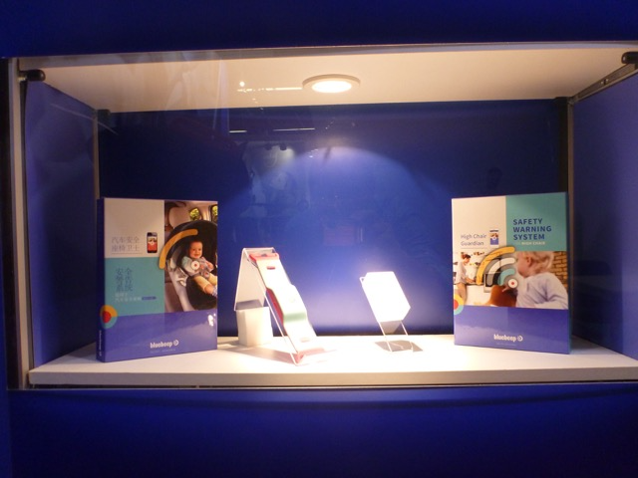

Slide 22
Investissement PME
I R
ISF
Réduction
18%
50%
Plafond d’investis. célib. /couple
50 k€/100k€
90k€
Plafond de réduction
9k€/18k€
45k€

